Slide 1

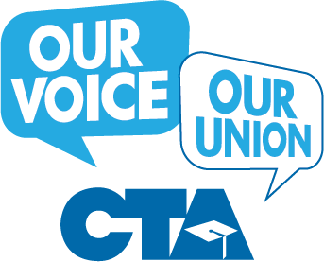
Our Union:
All Members,
One Goal!
Maintaining Our Power to Stand Up for Our Students and Our Profession after the Loss of Fair Share
Notes:
Everything VTA members do is centered around our students.
VTA’s Goal: Powerful, high-participation school sites to ensure quality public education for all students!

Slide 2

154 Years of Proven Success
Free School for All
First legislative victory establishes free school for all students—including non-white students.
1866
First Fair Dismissal Law
Won a State Supreme Court ruling establishing due process.
1890
Created Teachers Retirement
CalSTRS created by legislature
just 3 years after CTA’s State Council called for it.
1913
Protest Japanese Internment
One of a few organizations to protest the internment of Japanese-Americans at the beginning of WW II.
1940
The more we succeed, the more we are attacked by those that seek to weaken our union and privatize public education by silencing our collective voice.
Notes:
Review the adage: We have to know where we come from before we can know where we are going.
CTA members have a proud history of standing up for quality public education for all students and elevating our profession. {we are all CTA – don’t third party)
Some of our accomplishments include:

Slide 3
154 Years of Proven Success
Won Bargaining Rights
CTA-sponsored Rodda Act passes, making K-14 educators the first public employees in California to win collective bargaining.
1975
Minimum School Funding
Wins passage of Proposition 98 guaranteeing a minimum amount of funding for K-14 schools.
1988
Defeated Anti-Union Initiatives
Led coalition to defeat slate of ballot measures to cut school funding, strip teachers of due process and silence our union.
2005
Passed Prop. 30 & 55
Won the largest tax increase on the wealthiest earners in the history of California, stopping cuts and bringing in $47 billion in new money for our students.
2016
The more we succeed, the more we are attacked by those that seek to weaken our union and silence our collective voice.
Notes:
CTA members have a proud history of standing up for quality public education for all students and elevating our profession. Some of our accomplishments include:

Slide 4

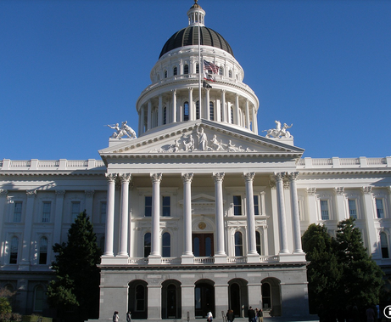
Attacks are Economic and Political
At the Ballot Box
Opponents have long sought to silence teachers and limit the role of unions through misleading initiatives. California voters have agreed with educators sending a clear message that they don’t support the corporate agenda.
In the Legislature
Every year, CTA members take positions on hundreds of bills that can help improve student achievement or destroy the teaching and learning environment.
Notes:
As too often is the case, the more we succeed, the more we are attacked by those that seek to silence our collective voice and weaken public education. Make no mistake, these attacks are economically and politically motivated. Historically, CTA members have been successful protecting the rights of students and educators, which is leading to a new strategy of attack. Having not found success at the ballot box or on the legislative floor -
3 props defeated
No legislation passed

Slide 5
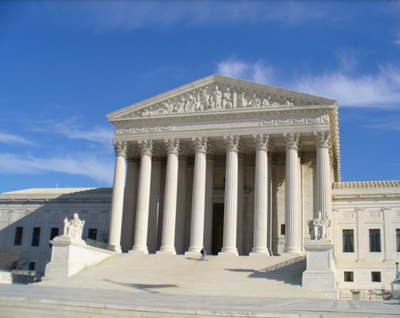
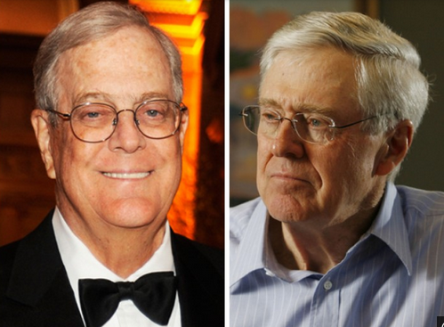
Attacks are Economic and Political
In the Courts
Not having much success at the ballot box or in state legislatures, many billionaires are hiring high-dollar legal teams and PR agencies to attack long-standing protections for union members.
Billionaires Club
Billionaires like the Koch Brothers and Eli Broad are spending exorbitant amounts of money to undermine our unions—ultimately seeking to turn public schools into profit centers.
The judicial system has become the new frontier for attacks on working people and our unions.
Notes:
Now our opponents – wealthy corporate interests – are going to court to undermine our rights
Adversaries are now looking to eliminate our collective voice in the courts.

Slide 6

What is Janus vs. AFSCME?
An Illinois state employee funded by powerful corporate interests sued his union AFSCME (American Federation of Federal, State, County, & Municipal Employees) challenging mandatory fair share (agency fees) as a violation of his U.S. constitutional rights.
The U.S. Supreme Court will hear the case this term and is expected to issue a ruling by June 2018.
Janus will decide the constitutionality of Abood v. Detroit Bd. of Educ., a 1977 case in which the Court allowed states to require all public employees to pay union dues or fair share fees.
Notes:
First, it seeks to abolish all fair share fees as unconstitutional – essentially, to impose “right to work”–for LESS for ALL public sector employees in all 50 states by judicial fiat.
Second, and as a fallback, it seeks to outlaw the “opt out” approach to fair share fees, under which the default rule is that non-members pay full fees, but may opt out and pay the reduced “chargeable” percentage.
Best case scenario: the Supreme Court denies review or upholds Abood.
Worst case scenario: the Supreme Court rules in Plaintiffs’ favor, overturns Abood, and outlaws fair share fees.
Bad case scenario: the Supreme Court ducks the fair share issue, but rules in Plaintiffs’ favor on the “opt out” issue.

Slide 7
What is Fair Share?
Let’s take a closer look at what Fair Share is and what it is not.
1
2
3
Fair Share is a common-sense way to ensure fairness and protect equity, individual rights, and the pocketbooks of educators.
Every educator who enjoys the benefits and protections of a negotiated contract should, in fairness, contribute to maintaining the contract.
Fair Share fees are not used for political or ideological activities.
Our Union:
All Members, One Goal!
Notes:
So what is Fair Share, exactly? Highlight points you think will be most impactful to individual
Fair Share is a common-sense way to ensure fairness and protect equity, individual rights, and the pocketbooks of educators.
Every educator who enjoys the benefits and protections of a negotiated contract should, in fairness, contribute to maintaining the contract.
Fair Share fees are not used for political or ideological activities. NEA and CTA conduct a thorough analysis of their finances each year, with review by an independent auditor, to ensure that the amount charged to fee payers does not include any political or ideological activities.
Fair Share does not force individuals to join CTA. In fact, Fair Share protects the individual rights of educators to choose whether to join the Association. Fair Share simply makes sure that all educators share the cost of negotiations for benefits that all educators enjoy, regardless of whether they are Association members.
Under Fair Share, all members enjoy the benefits, rights, and protections of the bargained contract, but the similarities end there. The importance and power of CTA membership cannot be overstated.

Slide 8
What is Fair Share?
Let’s take a closer look at what Fair Share is and what it is not.
4
5
Fair Share does not force individuals to join VTA/CTA. In fact, Fair Share protects the individual rights of educators to choose whether to join their union.
Under Fair Share, all members enjoy the benefits, rights, and protections of the bargained contract, but the similarities end there.
Our Union:
All Members, One Goal!
Notes:
So what is Fair Share, exactly? Highlight a point
Fair Share is a common-sense way to ensure fairness and protect equity, individual rights, and the pocketbooks of educators.
Every educator who enjoys the benefits and protections of a negotiated contract should, in fairness, contribute to maintaining the contract.
Fair Share fees are not used for political or ideological activities. NEA and CTA conduct a thorough analysis of their finances each year, with review by an independent auditor, to ensure that the amount charged to fee payers does not include any political or ideological activities.
Fair Share does not force individuals to join CTA. In fact, Fair Share protects the individual rights of educators to choose whether to join the Association. Fair Share simply makes sure that all educators share the cost of negotiations for benefits that all educators enjoy, regardless of whether they are Association members.
Under Fair Share, all members enjoy the benefits, rights, and protections of the bargained contract, but the similarities end there. The importance and power of CTA membership cannot be overstated.

Slide 9

What do you think?
Would it be fair if non-members (currently fair share fee payers) could continue to receive the benefits of union representation, collective bargaining, our contract: due process rights, wages, benefits, etc. without paying for any of the costs?
Our Union:
All Members, One Goal!

Slide 10

How Would Loss of Members Impact Other VTA members?
What would fewer dues dollars mean for bargaining, contract maintenance, organizing, conferences, workshops, social events, community outreach, advocacy, and more?
Our Union:
All Members, One Goal!
Notes:
So what could the loss of fair share mean to you and your local?
Highlight a point. Some examples include: lack of resources for release time, trainings and incentives; divided membership between members and free riders; weakened contracts because of aggressive principals/District admin.; Less CTA staff support for contract enforcement issues; Other quasi organizations offering legal services to members…

Slide 11
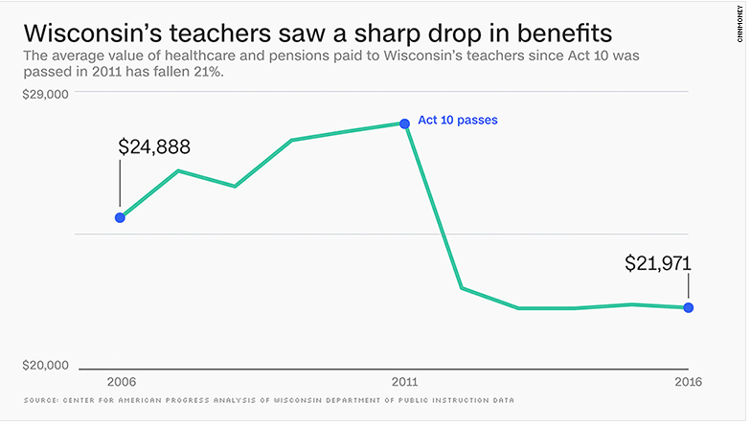
After Wisconsin’s teachers lost fair share fees…..

Slide 12
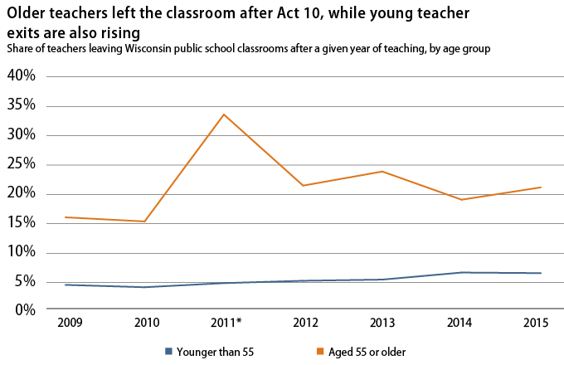
After Wisconsin’s teachers lost fair share fees…..

Slide 13
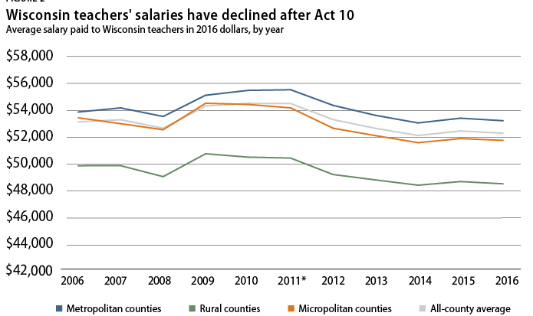
After Wisconsin’s teachers lost fair share fees…..

Slide 14

The POWER of OUR Union Membership
Through high-union participation we gain:
Lower class sizes / caseloads
Higher wages & benefits
More secure retirement
Better teaching & learning conditions
More say in our profession
Better public schools for our students!
Our Union:
All Members, One Goal!
Notes:
1. For Public Education
-Belonging to California’s leading education organization
-Unity and collective action as tools for better contracts for educators and students
-Communications and political advocacy to be informed and involved
-A voice in your chapter’s agenda
2. For Your Career
-Professional development
-Certification guidance
-CTA conferences and trainings
-National Board Certification
-Special Education training
3. For Your Rights
-Legal representation
-Access to experts on educator rights
-$1 million in work-related liability insurance
4. For Your Wallet
-MANY CTA/NEA Member benefits and discounts

Slide 15

Beware of the wolves in sheep’s clothing
There will be deceptive groups who identify as “Alternatives” to our union and make empty promises.
They won’t tell you who’s really behind them or where they get their funding.
They will contact you and encourage you to “Drop your membership” because they know our collective power comes from membership.
Eventually fewer members could mean lower wages & benefits, a less secure retirement and lower education funding for our students.
Notes:
Visit wrongforeveryone.com to learn more about

Slide 16
So what can we do?
Pledge to stand together for our students and our profession!
Sign a commitment card today.
Our Union:
All Members, One Goal!

